Slide 1


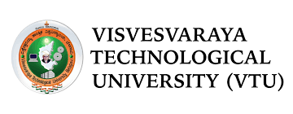

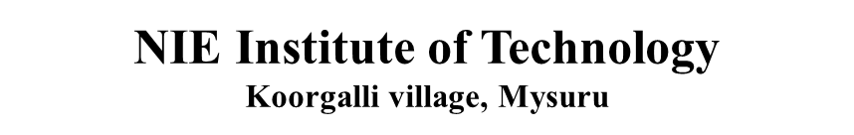


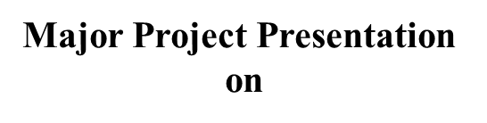


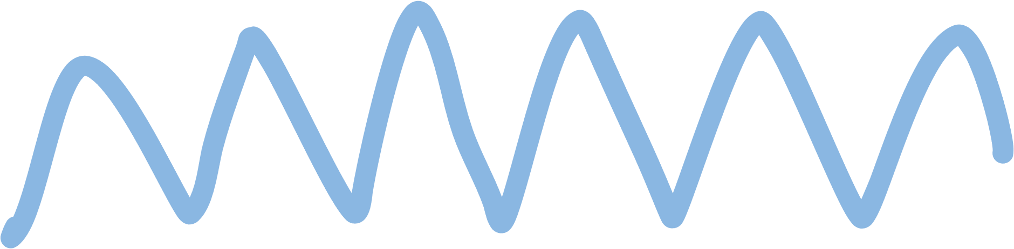
TWO WAY COMMUNICATION SYSTEM FOR DEAF PEOPLE
Under the guidance of:
Dr Nandini M S
Head of Dept.
Information Science
Name of the Student:
Kushal babu N
ISE 8th sem

Slide 2


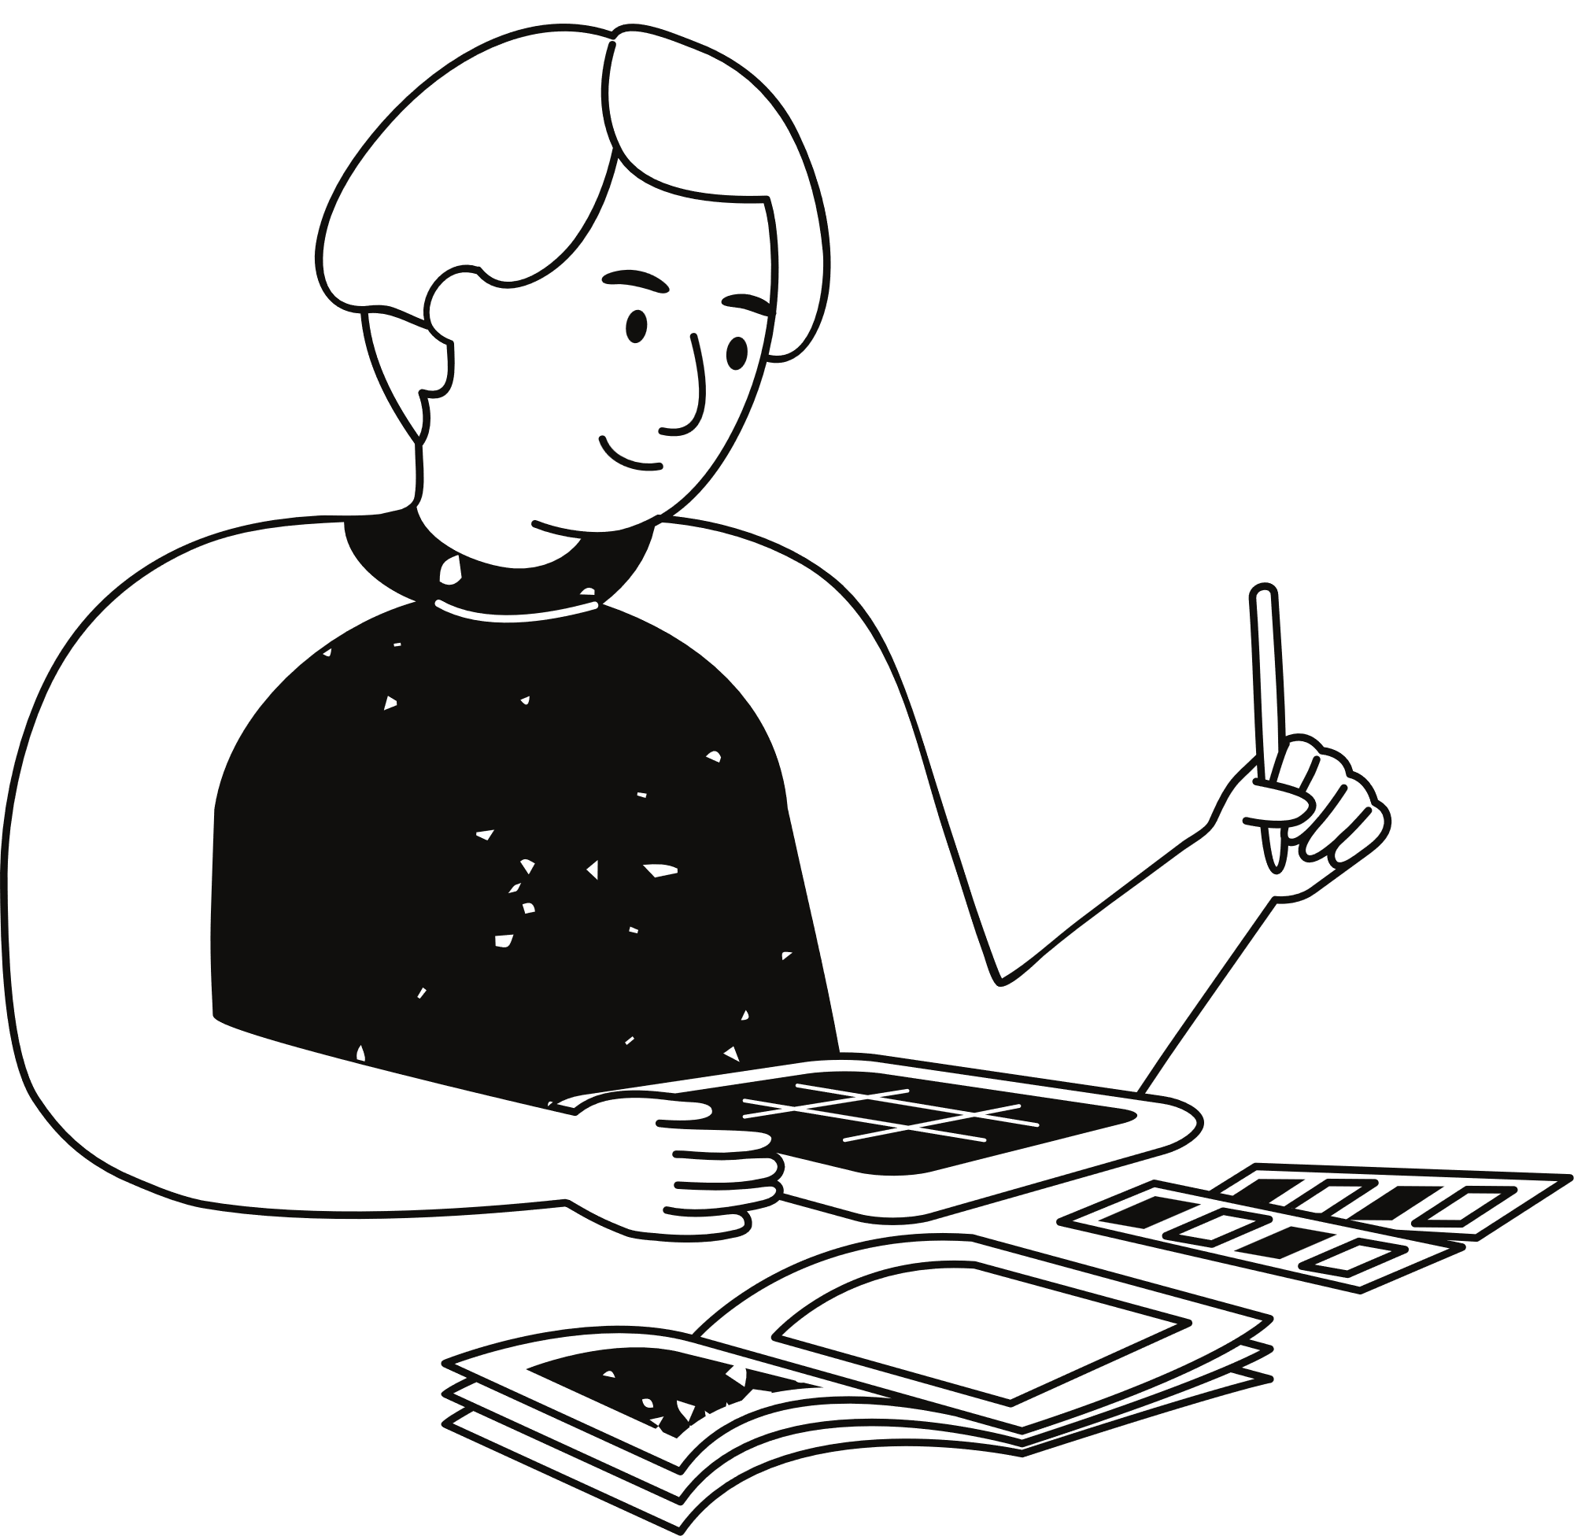

Problem statement
Design a Sign Language Recognition tool to enable real-time, two-way communication between deaf and dumb individuals and hearing people. This tool will recognize and translate sign language gestures into spoken or written language, and convert spoken language into visual or text-based cues. Leveraging gesture recognition, it aims to overcome communication barriers by providing an intuitive, accessible interface for effective interaction.

Slide 3



The proposed system has learning material for deaf children which has an impact on them in learning language basics
01.
OBJECTIVES
The primary goal of the project is to create a system that functions without requiring constant manual intervention. This automation ensures that the system can operate efficiently and consistently, providing reliable results and support for its intended users.
This application converts images to text, which helps children to learn
02.
The skill will go a long way in their life in the context of school and afterwards
03.

Slide 4
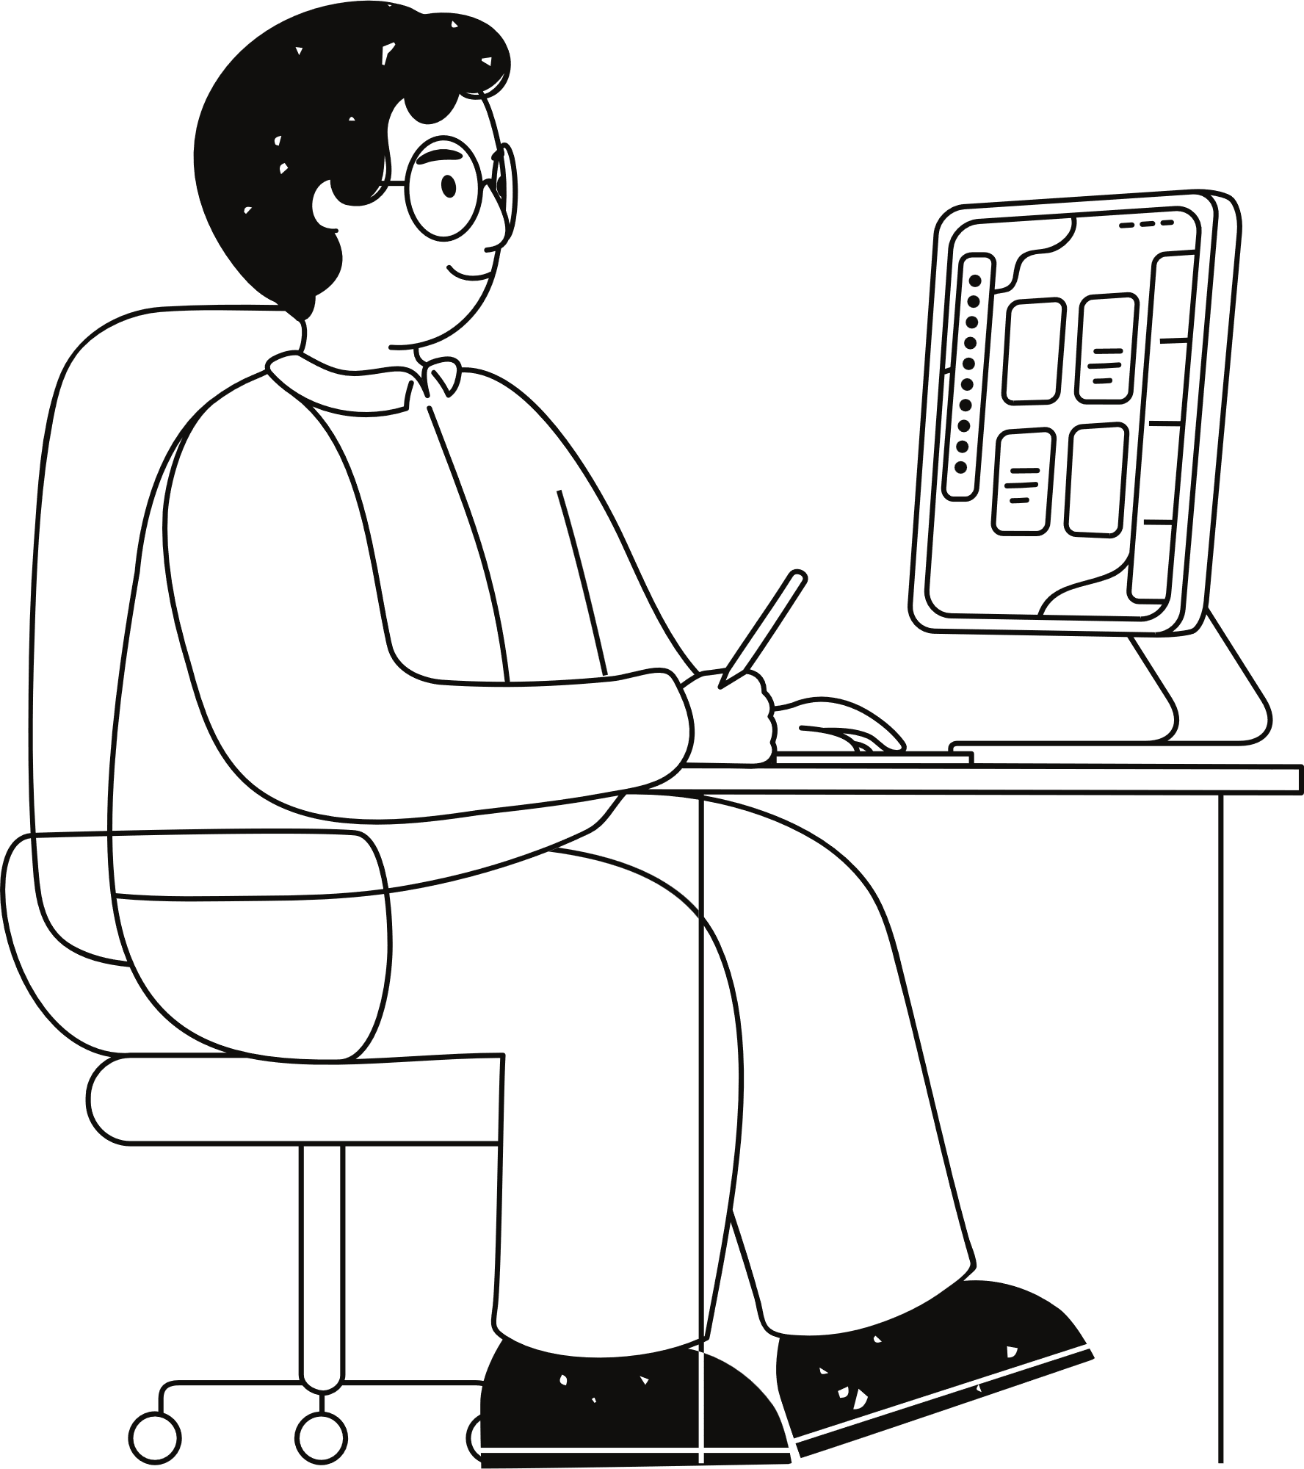
PROPOSED SYSTEM
This project has two phases :
It converts the audio, message into the sign language.
It converts images into text/speech
In this it takes audio as input, search that recording using Google api, display the text on screen and finally it gives sign code of given input using Sign Language generator.

Slide 5
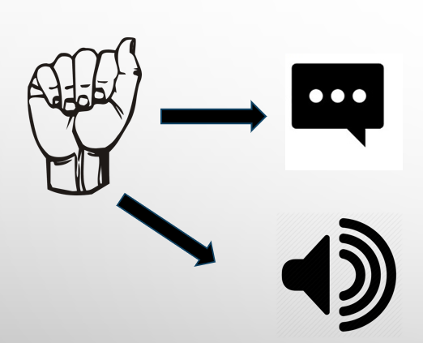
EXISTING SYSTEM
There have been many projects done on the sign languages that convert sign language as input to text or audio as output
Paper Title | Authors | Summary | Drawbacks
A Survey of Sign Language Recognition and Translation Systems | Sharma et al. (2020) | Reviews various approaches to sign language recognition and translation systems. | High computational requirements; Limited vocabulary coverage.

Slide 6
Paper Title | Authors | Summary | Drawbacks
Real-time Sign Language Translation using Machine Learning | Chen et al. (2019) | Discusses the use of machine learning for real-time translation between sign language and text. | May struggle with context understanding; Recognition errors with complex signs.
An Interactive Gesture Recognition System for Deaf and Hearing-Impaired People | Kumar & Kumar (2021) | Describes an interactive system that translates gestures into text and speech. | Ambiguities in gesture interpretation; Dependence on lighting and camera quality.
Two-Way Communication for Deaf and Hard of Hearing Individuals: A Review | Smith & Johnson (2018) | Reviews existing technologies for facilitating two-way communication. | Limited support for regional sign languages; Hardware costs may be prohibitive.
Gesture Recognition Systems for Deaf Communication: Challenges and Future Directions | Wang et al. (2022) | Discusses challenges in gesture recognition systems and proposes future directions. | Requires extensive datasets for training; Lack of emotional context in translations.

Slide 7


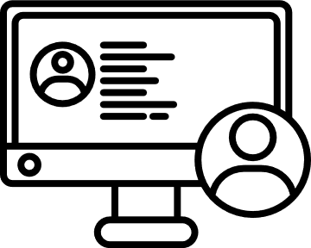
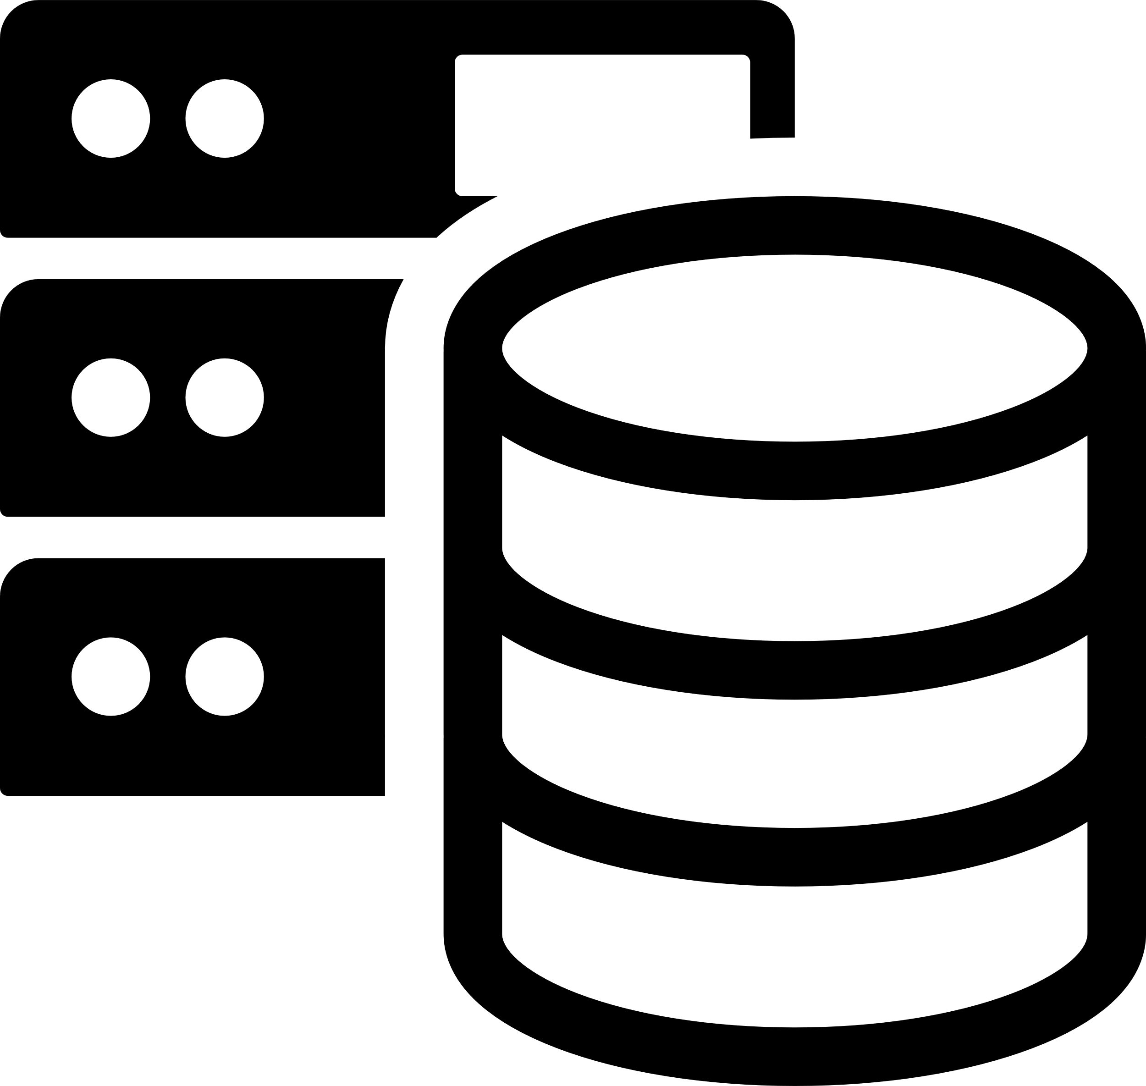
SYSTEM REQUIREMENTS
HARDWARE REQUIREMENTS
SOFTWARE REQUIREMENTS
Processor : Intel i5(min)
Hard Disk : 40 GB (min)
Ram : 4GB
Operating system : Windows 7 and above.
Coding Language : Python.
Framework : Django
Front End : HTML, CSS, JAVASCRIPT
Back End : SQLite

Slide 8
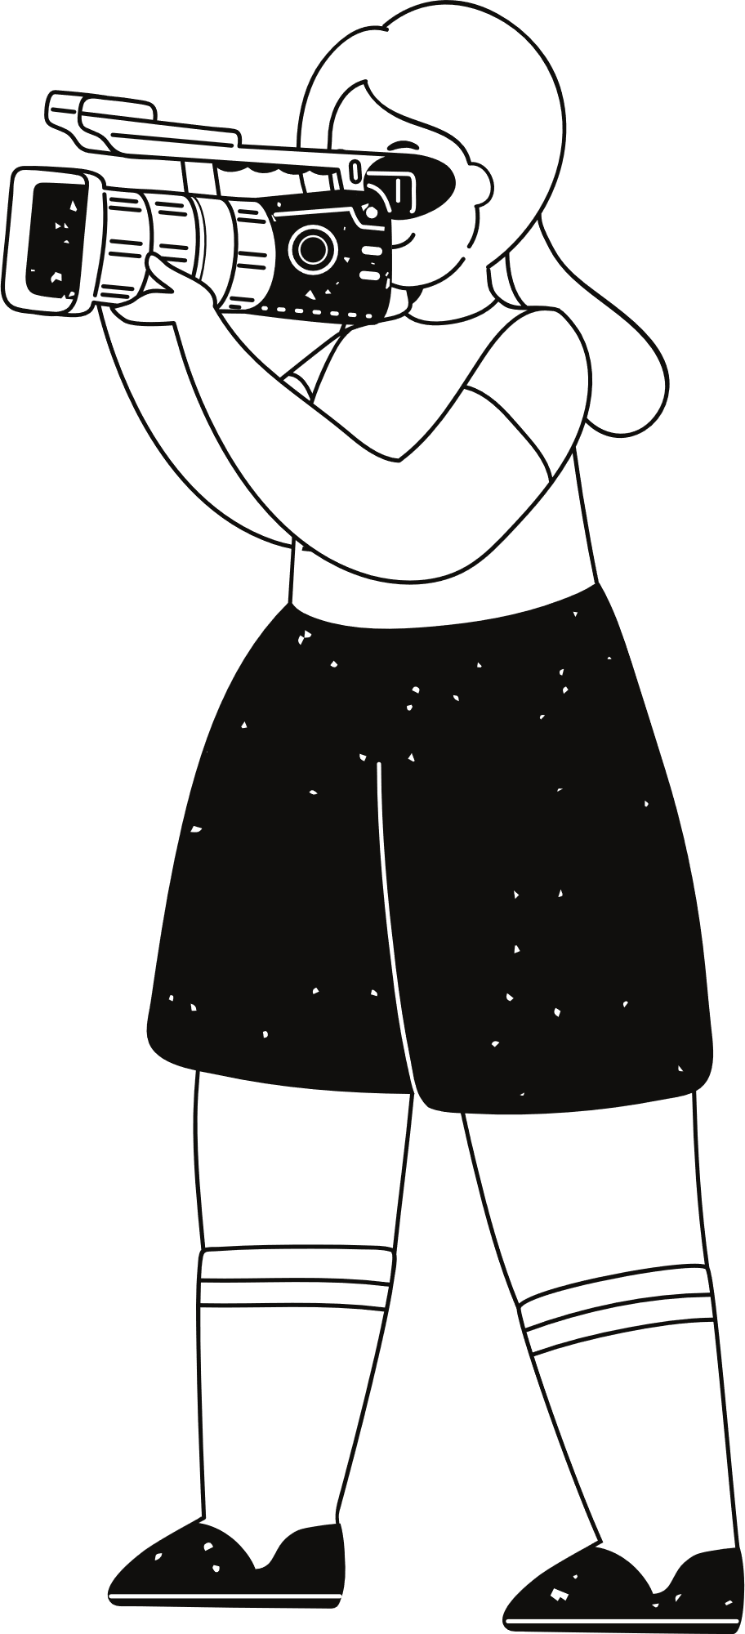
Python
NLP
Natural Language Processing (NLP) preprocessing involves several steps to prepare textual data for analysis and model building. Key steps include tokenization (splitting text into smaller units), lowercasing (ensuring uniformity), and removing punctuation. Stop words are removed to reduce noise, while stemming and lemmatization reduce words to their base forms for consistency.
Python libraries simplify the process of building, training, and validating ML/DL models. With TensorFlow and PyTorch, for instance, one can define and train neural networks with just a few lines of code.These libraries offer various optimization algorithms and tools for monitoring the process and improving model performance.
Django
Deep Learning
Deep learning is a subset of machine learning focused on neural networks with many layers, known as deep neural networks. These models are designed to automatically learn and extract intricate patterns and features from large datasets through hierarchical layers of neurons, mimicking the human brain's structure and function.
Django is a high-level Python web framework designed for rapid development and maintainable websites. It follows the Model-Template-View (MTV) architecture, featuring a powerful ORM for database interactions, an automatic admin interface, and built-in security measures against common threats.

Slide 9
Ideation process
01
02
03
04
Preprocessing
the data
Dictionary Based
Machine
Translation
Results
Data Collection

Slide 10
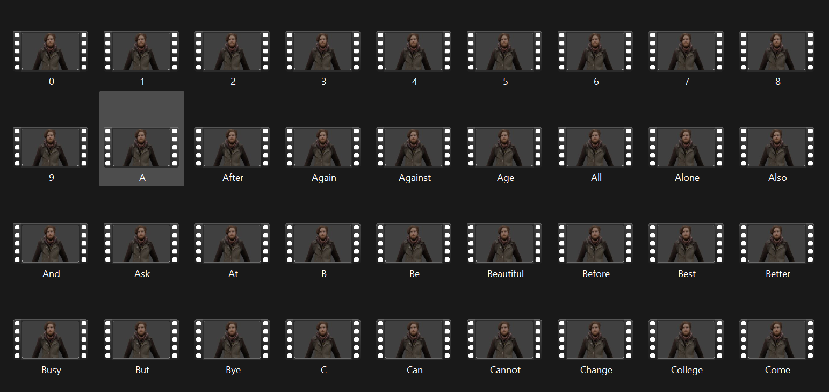
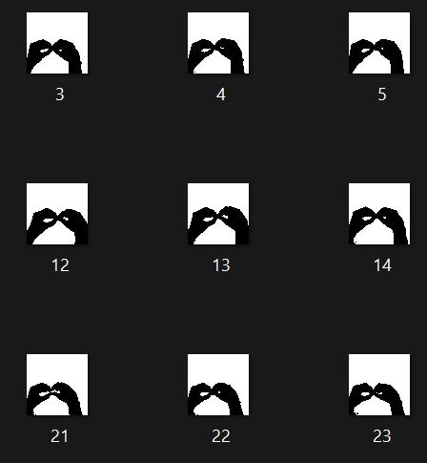
Data sets :

Slide 11
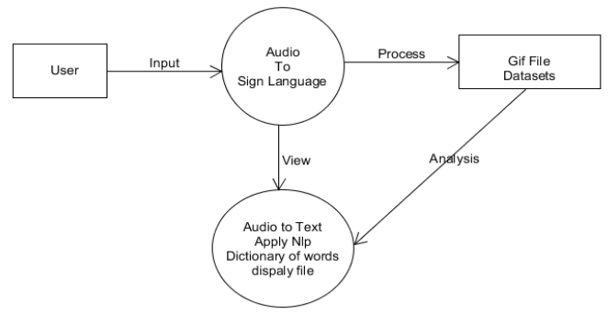
Phase I:

Slide 12
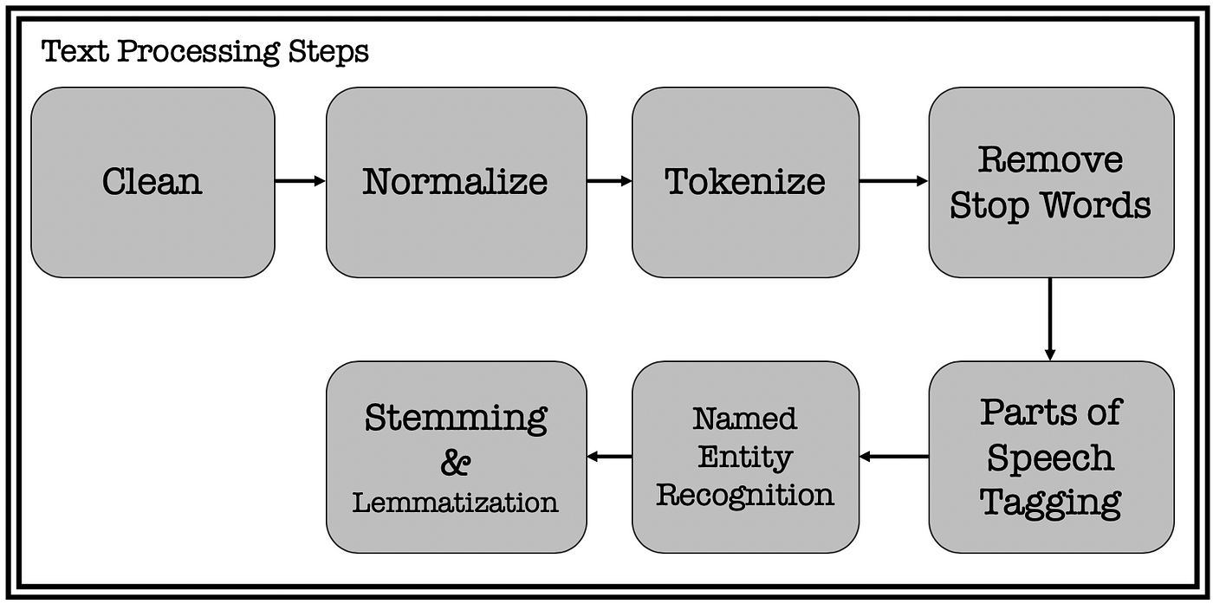

Slide 13
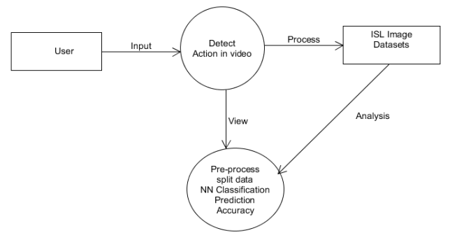
Phase II:

Slide 14
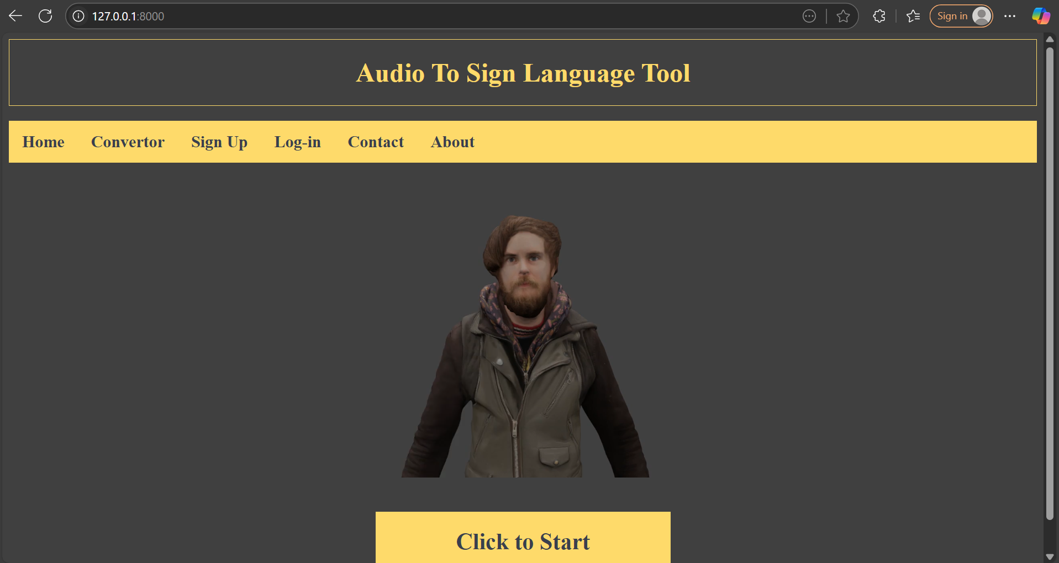
Results:

Slide 15
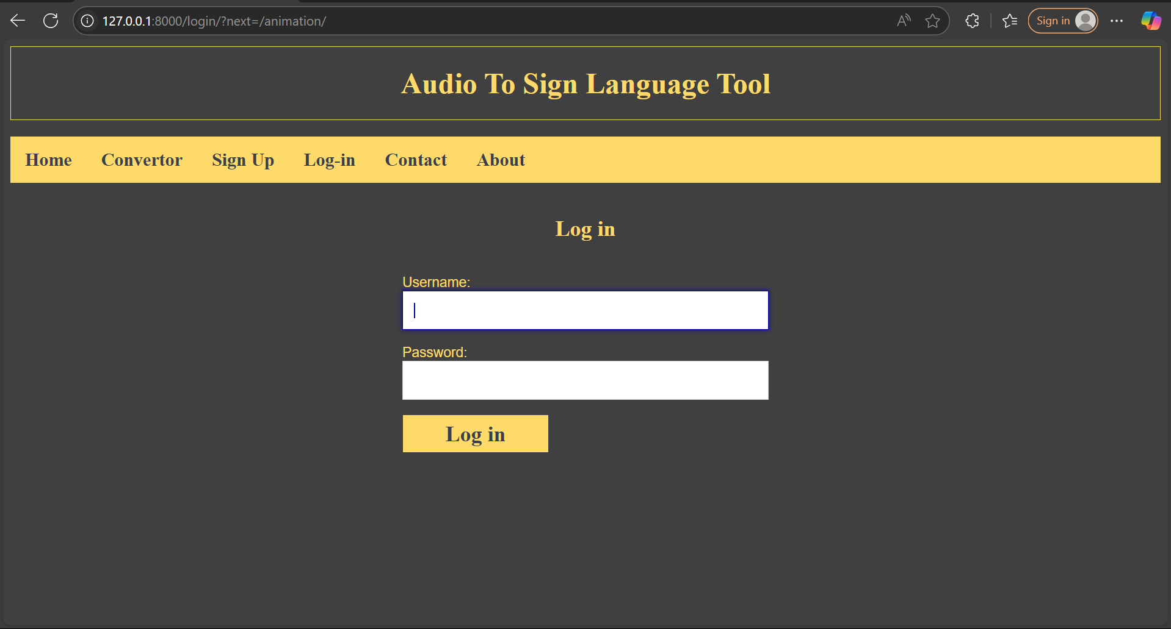
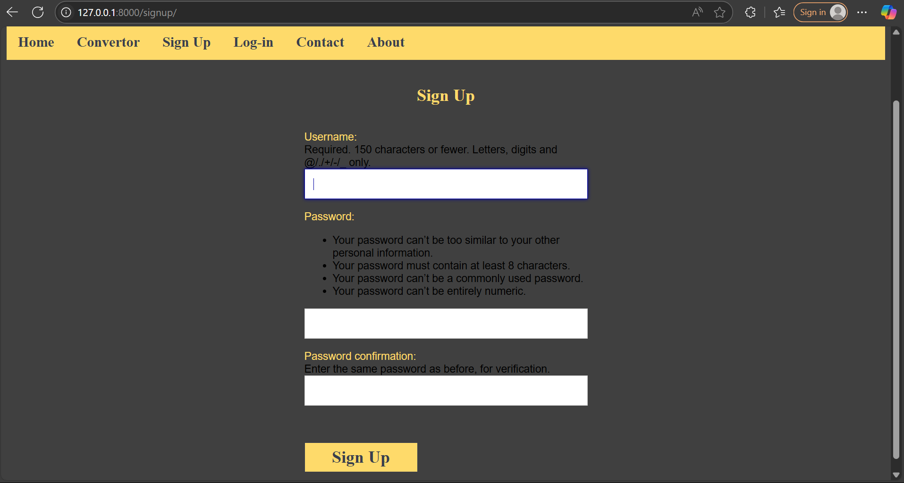

Slide 16
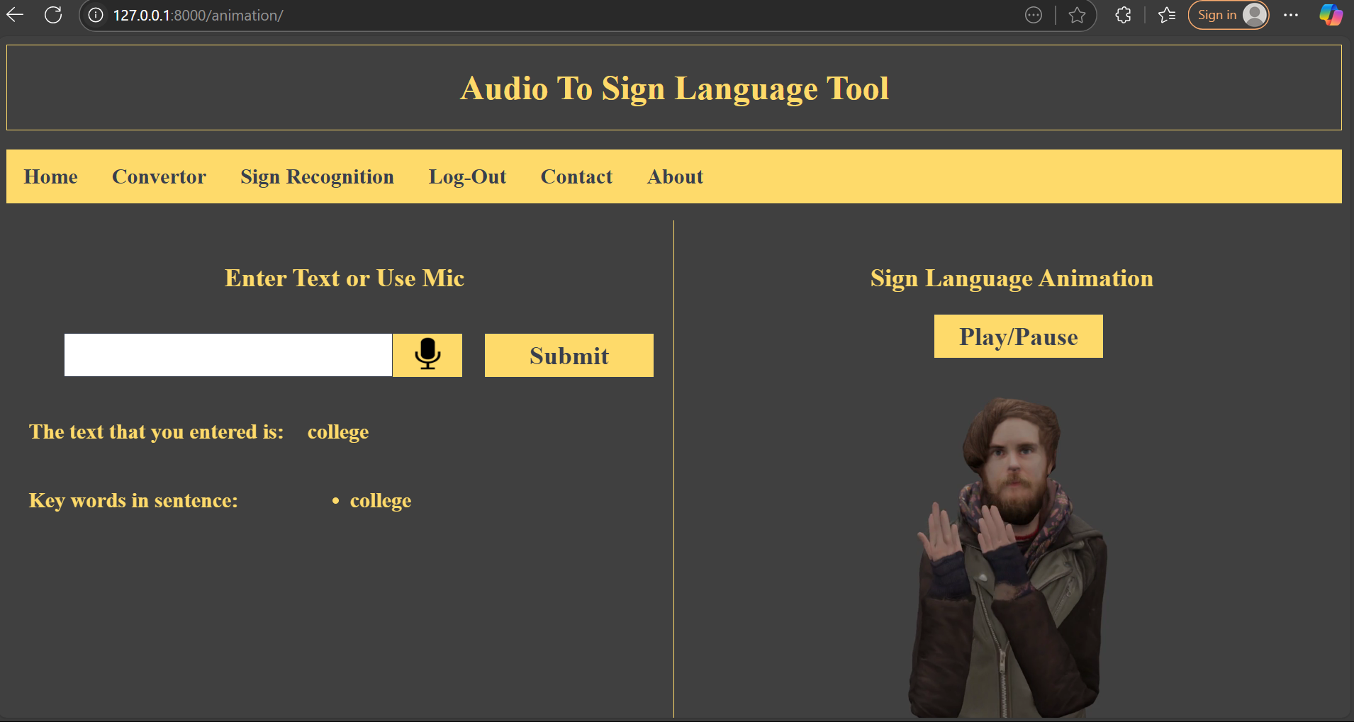

Slide 17
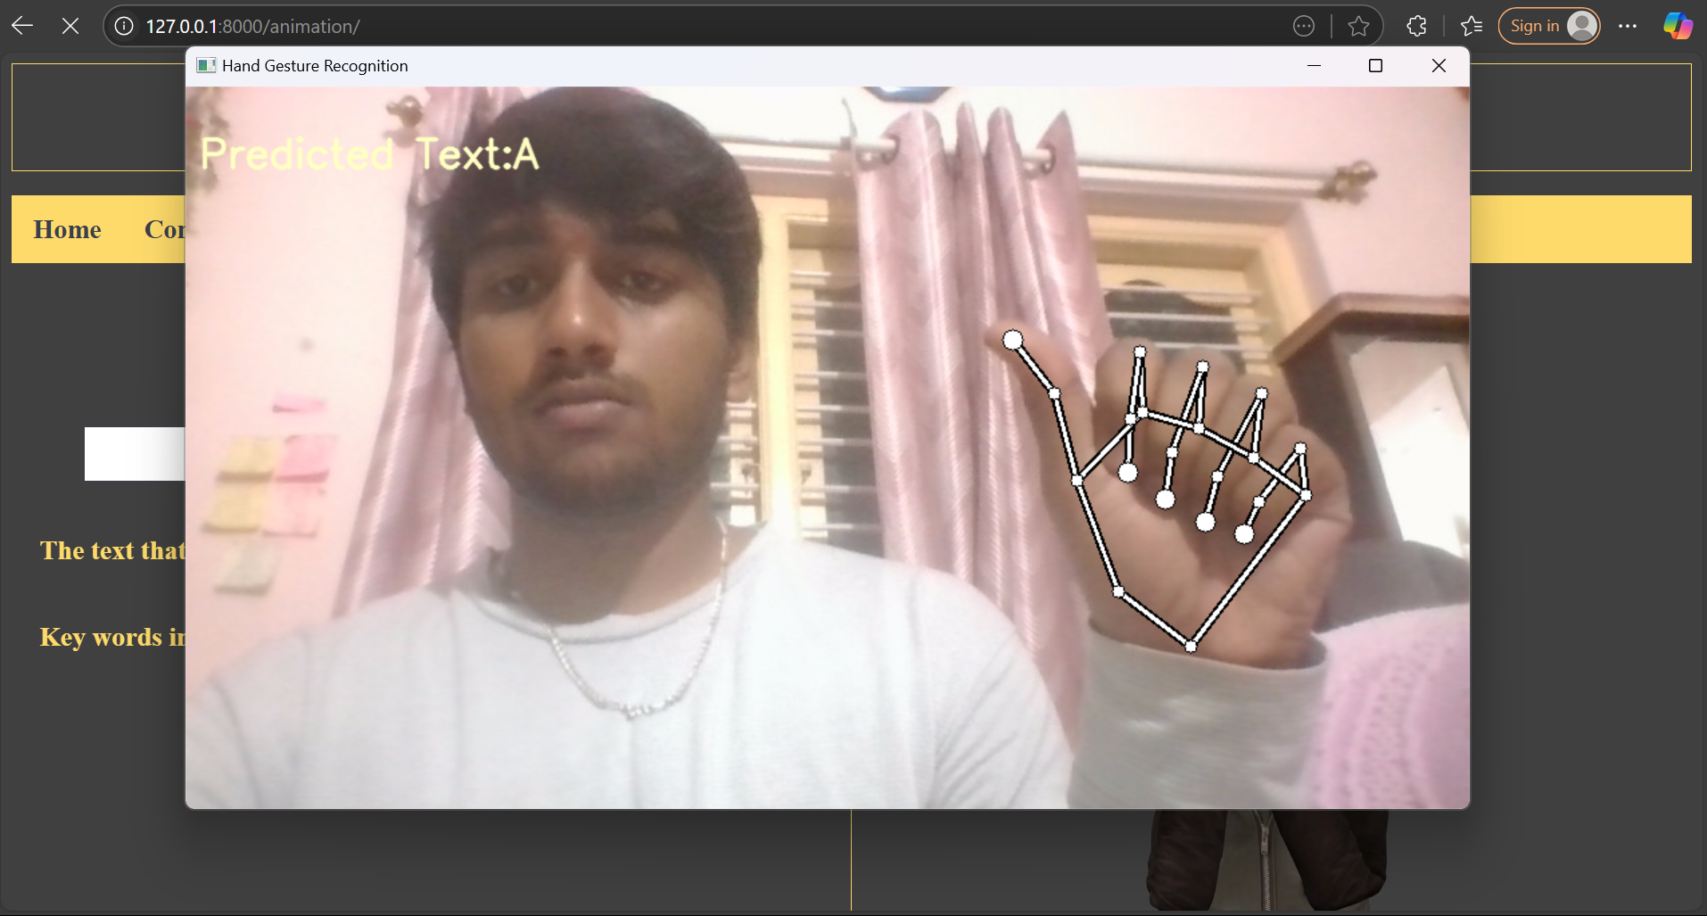

Slide 18
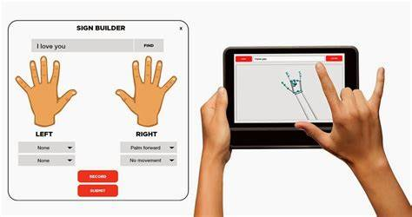
Educational Tools:
Sign Language Videos: Videos demonstrating sign language vocabulary, grammar, and usage, often available on platforms like YouTube or specialized educational websites.
Captioned Content: Educational videos and media with accurate captions to ensure deaf students can follow along.
Interactive Whiteboards: Used in classrooms to visually display information, facilitating engagement and understanding.
Sign Language Dictionaries and Books: Resources that provide comprehensive guides to sign language vocabulary and usage.
Visual and Tactile Learning Aids: Tools such as flashcards, charts, and tactile books that use textures and colors to convey information.

Slide 19
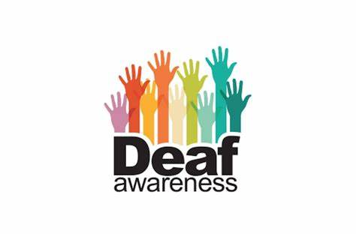
Public Awareness Campaigns:
Launching campaigns to raise awareness about the benefits and availability of the communication system, encouraging broader societal acceptance and use.
Use TV, radio, and social media to share stories, facts, and testimonials.Create and distribute public service announcements (PSAs) featuring sign language users.
International Day of Sign Languages: Celebrated annually on September 23, this day promotes awareness of the importance of sign language.
Deaf Awareness Month: Observed in September, it includes various events and activities to raise awareness about the deaf community and sign language.

Slide 20
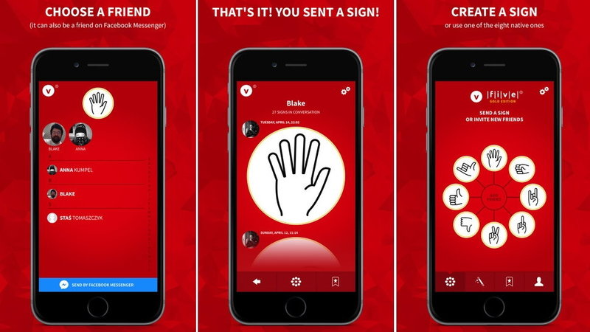
Final reflections and future steps
App Development:
Creating mobile and desktop applications that make the communication system widely available and easy to use.Use a framework like TensorFlow Lite or PyTorch Mobile to run the model on mobile devices.Alternatively, use a cloud-based service to handle the heavy lifting if the model is too large for mobile devices.

Slide 21
Thank you very much!

